Slide 1

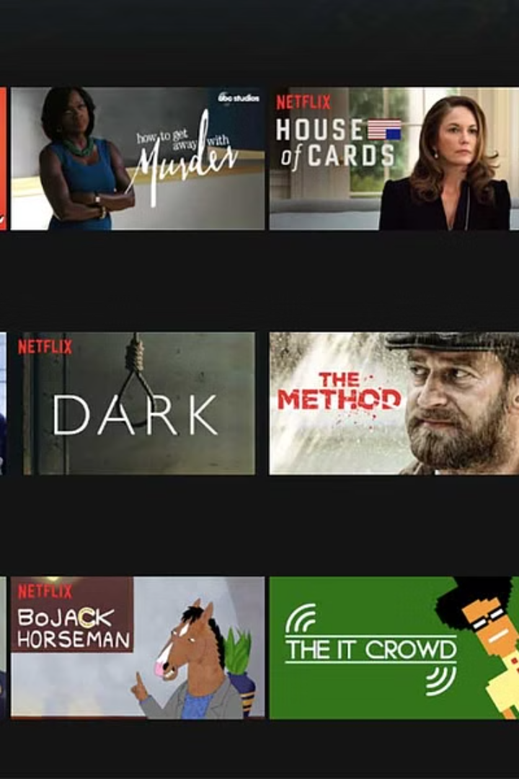
MINOR PROJECT
Netflix Recommendation System
AMIT KUMAR YADAV 2105690
SHRESTHA MISHRA 2105666
PRANJAL SINGH 2105638
OM SINGH 2105634
SAHIL RAJ SINGH 2105653

Slide 2

Objective :
Analyze Netflix data using dataset preprocessing, Tableau visualization, and cosine similarity in machine
learning. Enhance content recommendation algorithms and optimize audience engagement strategies
on the platform.
Working Principle :
Gather and merge Netflix data from TMDB and IMDb, emphasizing release years, genres, ratings, and popularity metrics.
Preprocess the dataset for analysis, utilize Tableau for interactive visualizations on dashboards.
Apply cosine similarity in machine learning for refining content recommendations and improving viewer engagement strategies.

Slide 3
Dataset
Source :
Kaggle
Size :
The dataset initially contains 8,807 entries (rows) and 12 features (columns).
Duplicates :
There are no duplicate rows in the dataset, which means each entry is unique.
Missing Values:
Values missing in ‘director’,’cast’,’country’,’date_added’,’rating’,’duration’ columns.

Slide 4
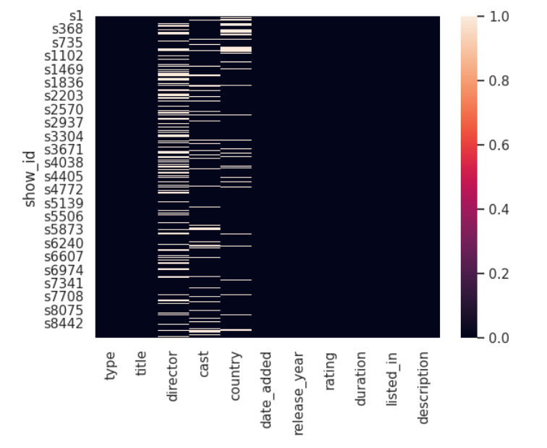
Data Cleaning
Handling Missing Values :
Columns with missing data: "director", "cast", "country"
Replaced missing values with "Unknown"
Dropped rows with null values in "rating", "duration", and "date_added"
Date and Time Handling :
Converted "date_added" column to datetime format
Extracted "loading_Year" and "loading_Month" from "date_added"
Dropped the original "date_added" column
Splitting the "duration" Column :
The "duration" column contained a mix of minutes and seasons
Extracted the numeric value and the unit into separate columns

Slide 5
Data Exploratoration and Visualizations

Slide 6
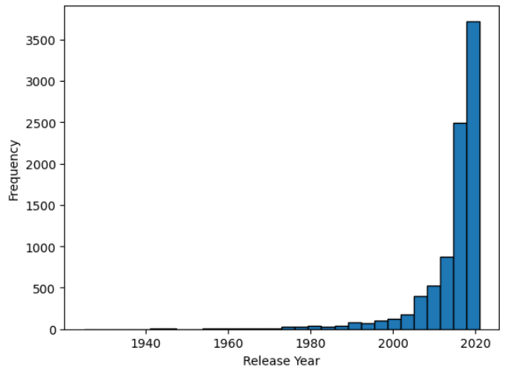
Histogram of Release Year Distribution
This plot shows the distribution of movies and TV shows by the release year. The plot demonstrates that the majority of the content was loaded in 2019 and 2020.

Slide 7
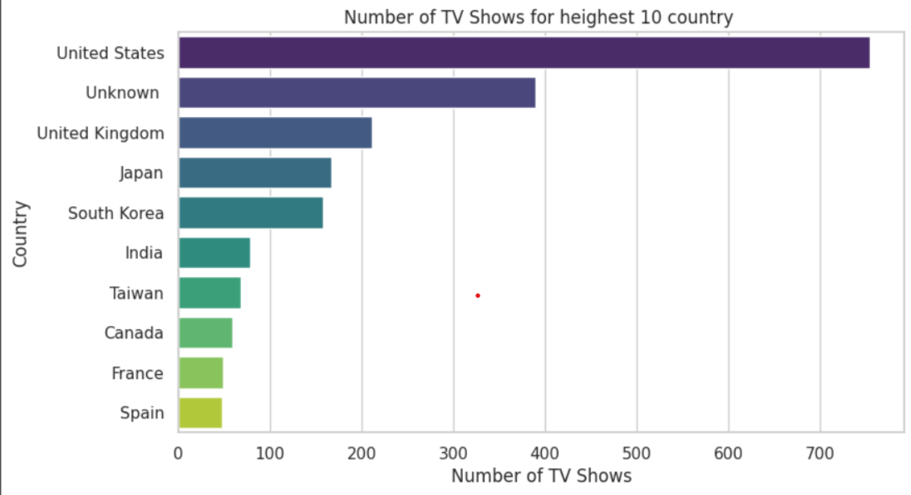
v
Number of TV Shows by Country
This plot provides a clear visualization of the distribution of Netflix TV show content across different nationalities, highlighting the dominance of the United States as the primary source of TV programming on the platform.

Slide 8
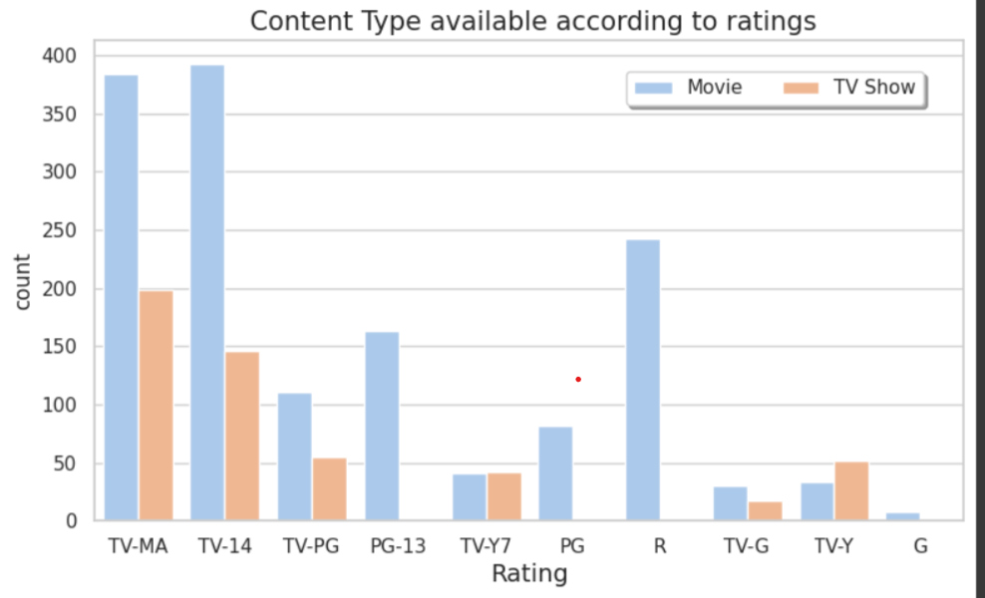
Content Distribution by Rating on Netflix
The graph shows the breakdown of Netflix content by type (movies vs. TV shows) and rating. Movies outnumber TV shows across most rating categories, except for TV-Y where TV shows are slightly more in number. The highest concentration is in the PG-13 and TV-MA rating levels.

Slide 9

Netflix Recommendation System
Feature Engineering :g
A new column "tags" is created by concatenating the "description", "listed_in" columns.
This "tags" column will be used as the basis for the content-based recommendation system.

Slide 10

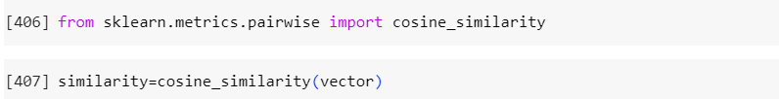
Netflix Recommendation System
Recommendation Model :
The CountVectorizer from scikit-learn is used to convert the "tags" text data into numerical feature vectors.
Cosine similarity is calculated between the feature vectors to determine the similarity between movies/TV shows.

Slide 11
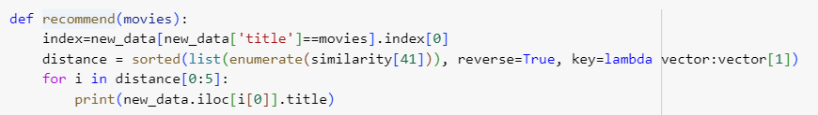
Netflix Recommendation System
Recommendation System:
A function "recommend()" is defined to provide the top 5 recommendations for a given movie/TV show title.
The function first finds the index of the input movie/TV show in the DataFrame, then uses the pre-computed cosine similarity matrix to identify the most similar items.

Slide 12
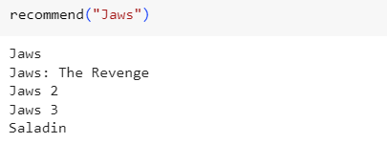
Output of recommend() t

Slide 13
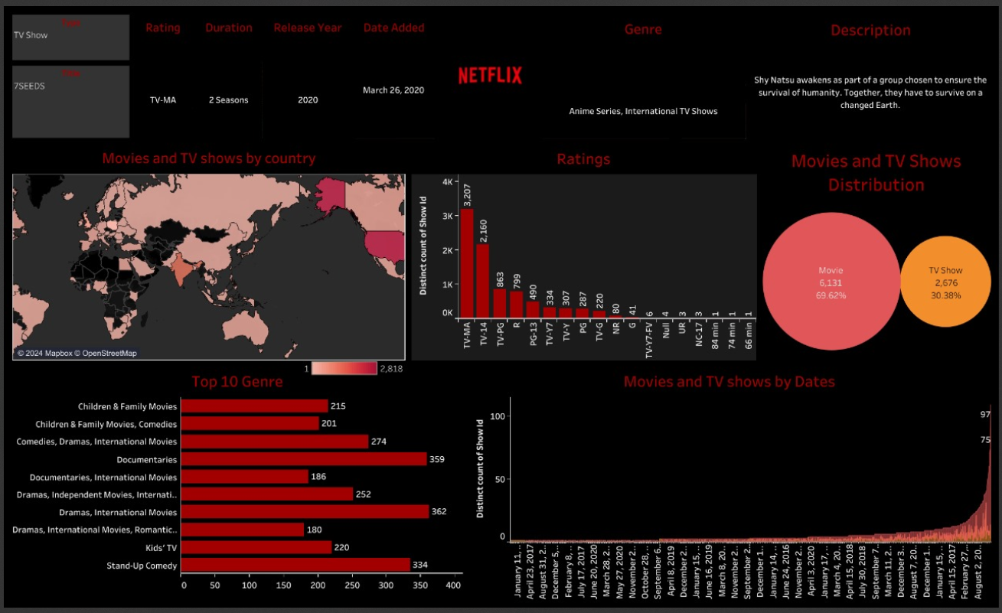
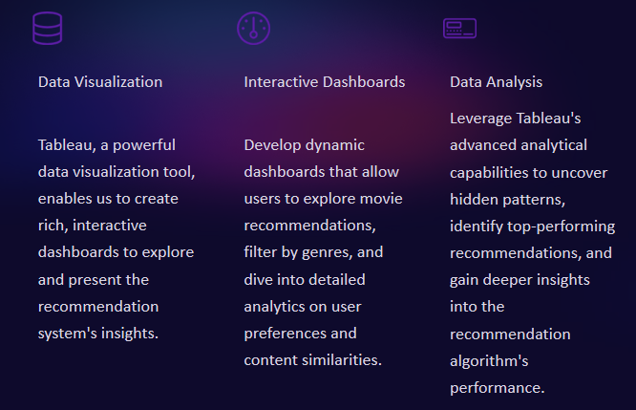
Visualizing the Recommendation System using Tableau

Slide 14
Future Scopes
Analyze user sentiment: Consider reviews and social media buzz to recommend trending content.
Cross-platform Integration: Aggregate user data across various platforms and devices to gain a comprehensive understanding of viewing habits, improving recommendation relevance.
Interactive User Feedback: Implement nuanced feedback options allowing users to fine-tune their preferences, leading to more accurate content suggestions.
Contextual Recommendations: Adapt recommendations based on the viewing context, such as time, mood, or company, for a more tailored user experience.
Ethical Algorithms: Ensure the recommendation system is transparent, bias-free, and promotes a diverse range of content, maintaining fairness and ethical standards.

Slide 15
Conclusion
1
Key Takeaways
2
Future Enhancements
The Netflix recommendation system leverages powerful machine learning techniques to provide personalized movie suggestions, enhancing user experience and driving subscriber retention.
Incorporating real-time user feedback, expanding to new content types, and incorporating contextual factors could further improve the recommendation system's accuracy and relevance.
3
Continuous Innovation
4
Responsible Development
As technology and user preferences evolve, Netflix will need to continuously refine and adapt its recommendation algorithms to maintain a competitive edge in the streaming landscape.
With the growing importance of ethical AI, Netflix must ensure its recommendation system adheres to principles of fairness, transparency, and user privacy.

Slide 16
Thank you very much!

